Slide 1

Fossil Fuels A Univariate Time Series Analysis

Slide 2
Univariate Analysis Workflow
Examine the raw time series by generating a raw plot
Detect the trend in the series using a linear model
Detrending if the trend is significant
Perform spectral analysis to determine dominant frequency and the period
Seasonal differencing to remove seasonality
Examine dependence structure using auto-correlation and partial auto-correlation plots, proposed an ARMA model
Conduct a Dickey-Fuller test to test stationarity and discuss results

Slide 3
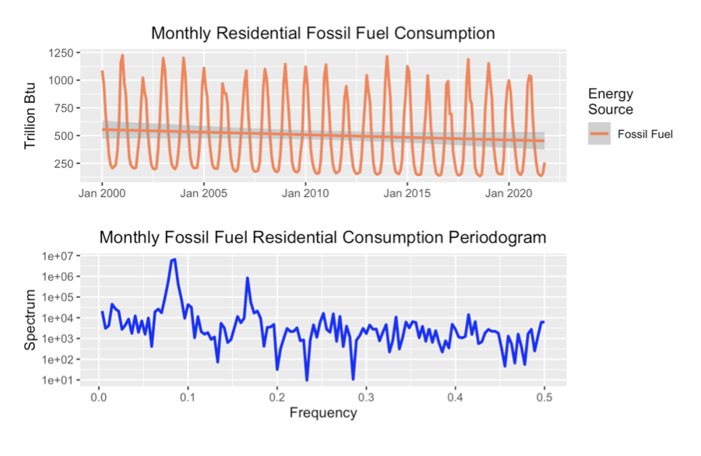
Trends and Spectral Analysis
The trend is not significant according to the linear model fitted to the series
The dominant frequency is at 1/12 which corresponds to an annual cycle.

Slide 4
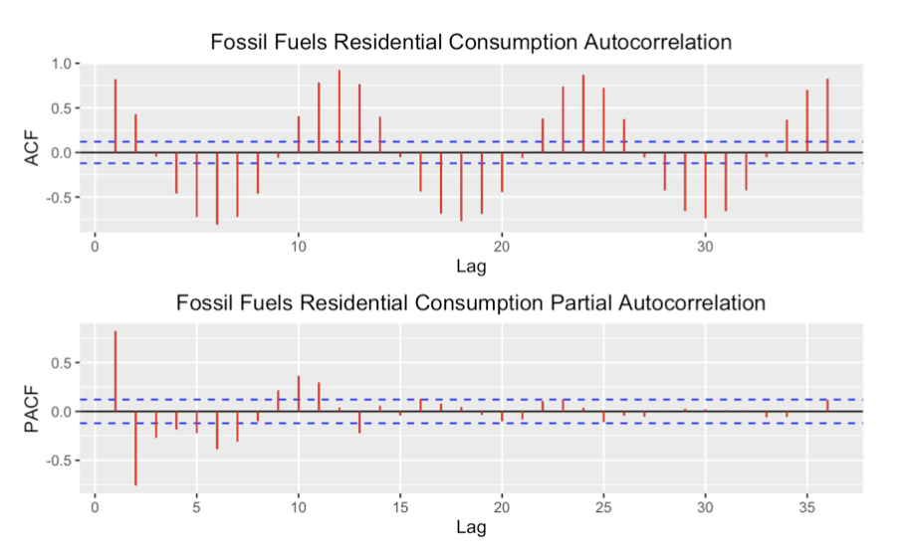
Dependence Structure and Stationarity Test
The ACF still have significant lag outside of first lag, meaning that the residual series may not be an AR(1) process.
The Dickey-Fuller test outputs a p-value of < 0.01 indicating strong evidence against non-stationarity.

